Slide 1
Kings County Real Estate Agency Pricing Model
By Arsh Patel and Musa Abbasi

Slide 2
Business Problems & Stakeholders
Our understanding of your needs :
You want to know what attributes affect house pricing the greatest, and we not only can tell you that, but have a model that can predict house prices within an accuracy of ~81 %
What you want
Attributes affecting price
What we have
Model predicting value based on significant attributes
Notes:
You want to know what attributes affect house pricing the greatest, and we not only can tell you that, but have a model that can predict house prices within an accuracy of ~80 percent

Slide 3
Data Source
Data on houses sold in Kings County, Washington in 2014..
We also used information about the general population in each town and zipcode in Kings County from another data source.

Slide 4
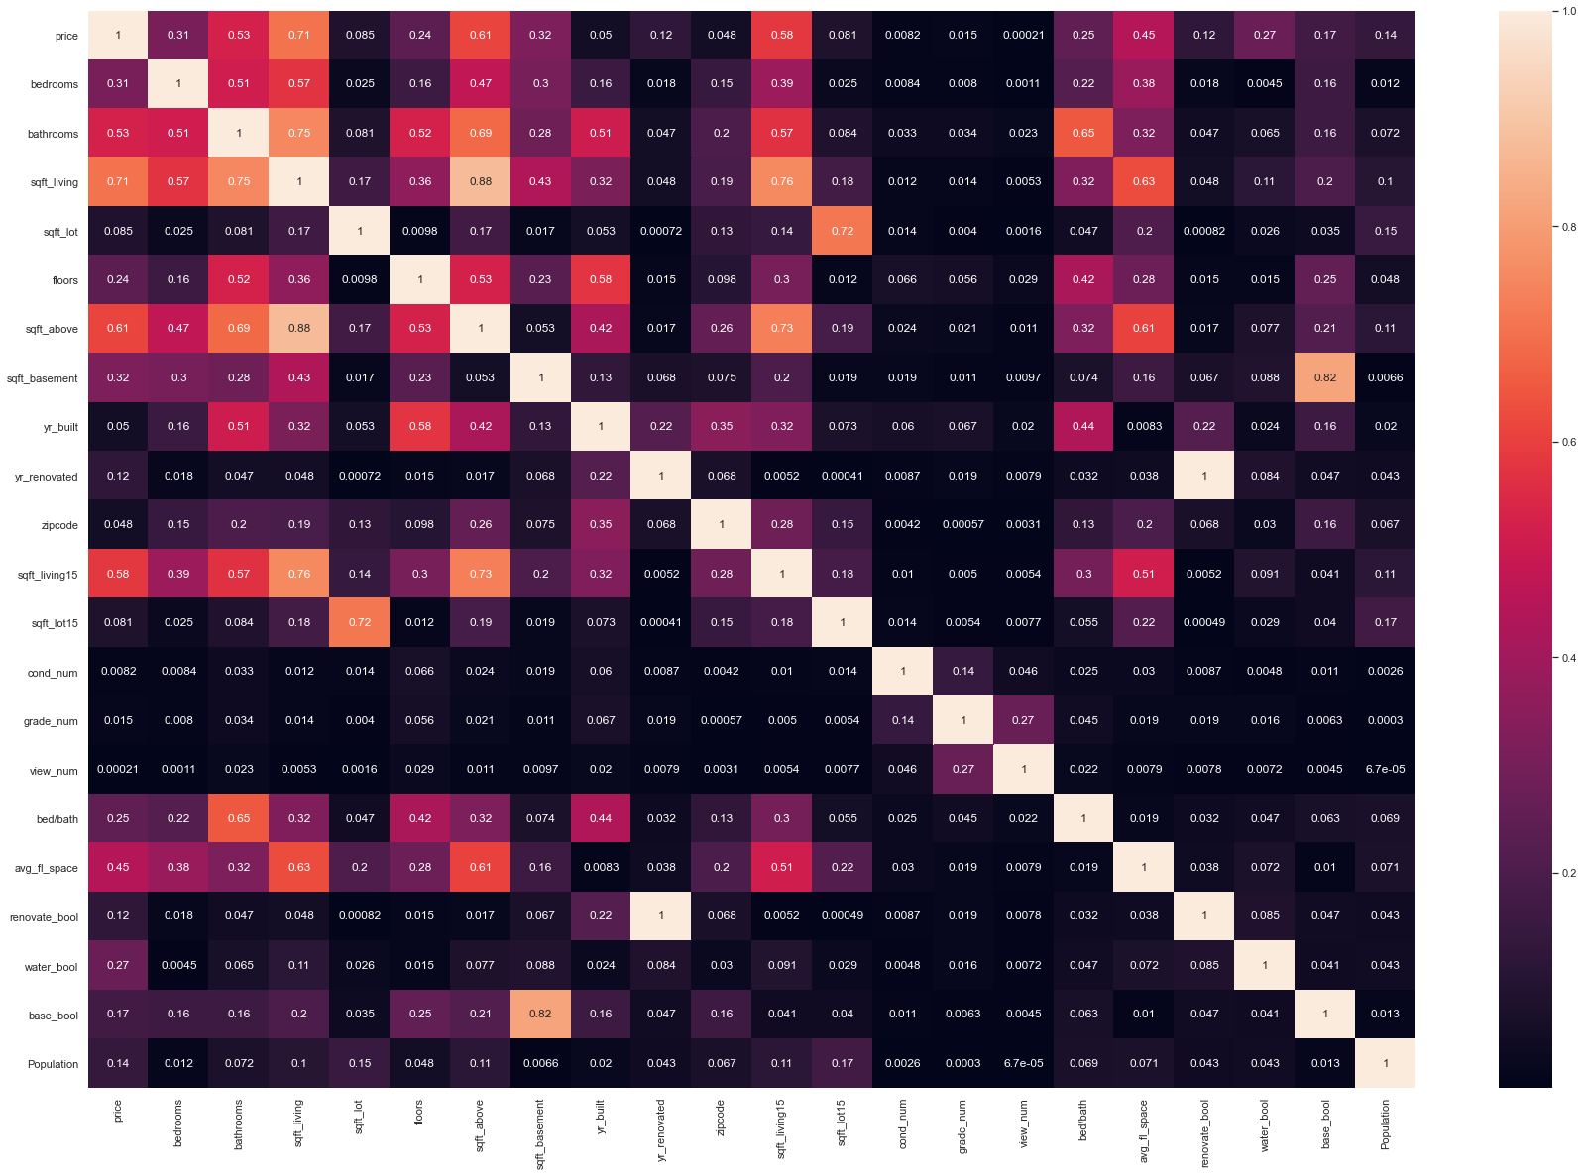
Initial Correlation Heatmap
Variables with highest correlation to Price (coefficient above 0.5)
Square footage of living space in the home
Square footage of house apart from basement
Square footage of living space in the home for the nearest 15 neighbors
Number of bathrooms

Slide 5
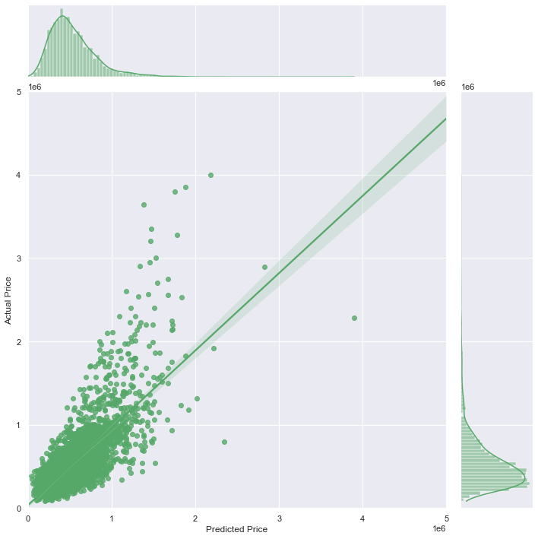
Baseline Model
Our first model was imperfect
Accuracy of 58%
R2 for test = 0.5673695068171001
MAE = 157043.84841828528

Slide 6
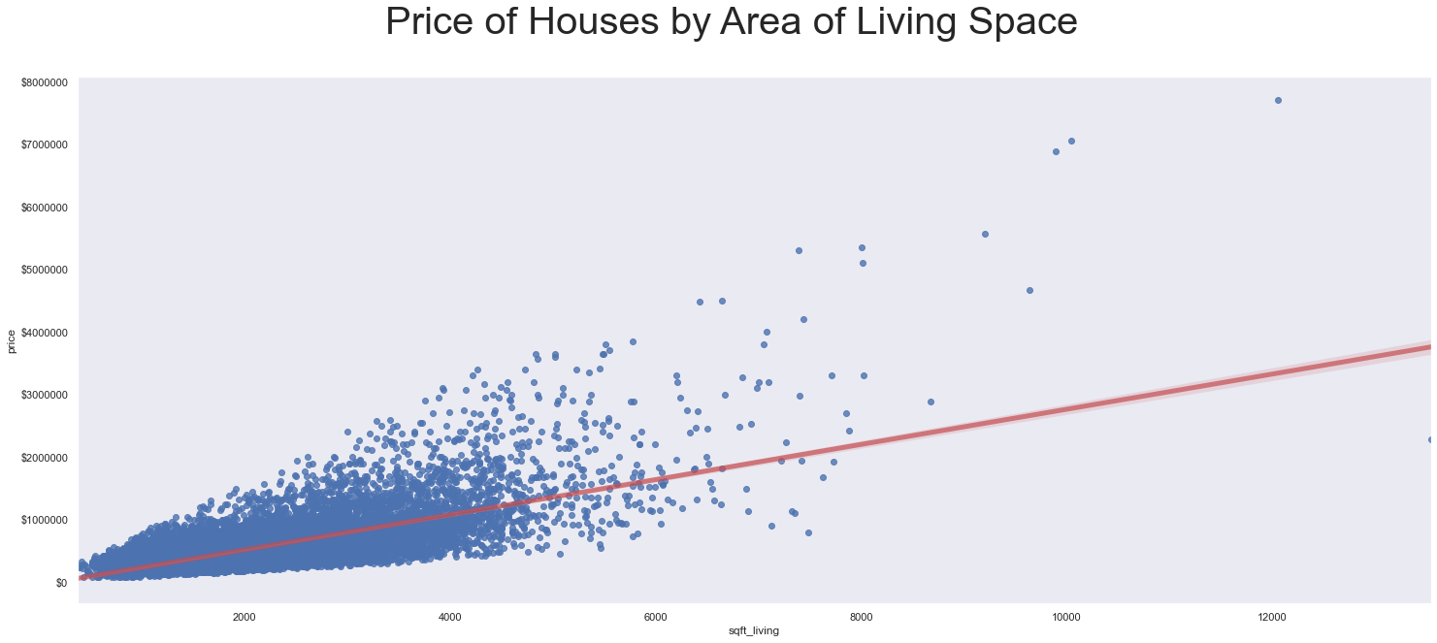
Variables important for modelling

Slide 7
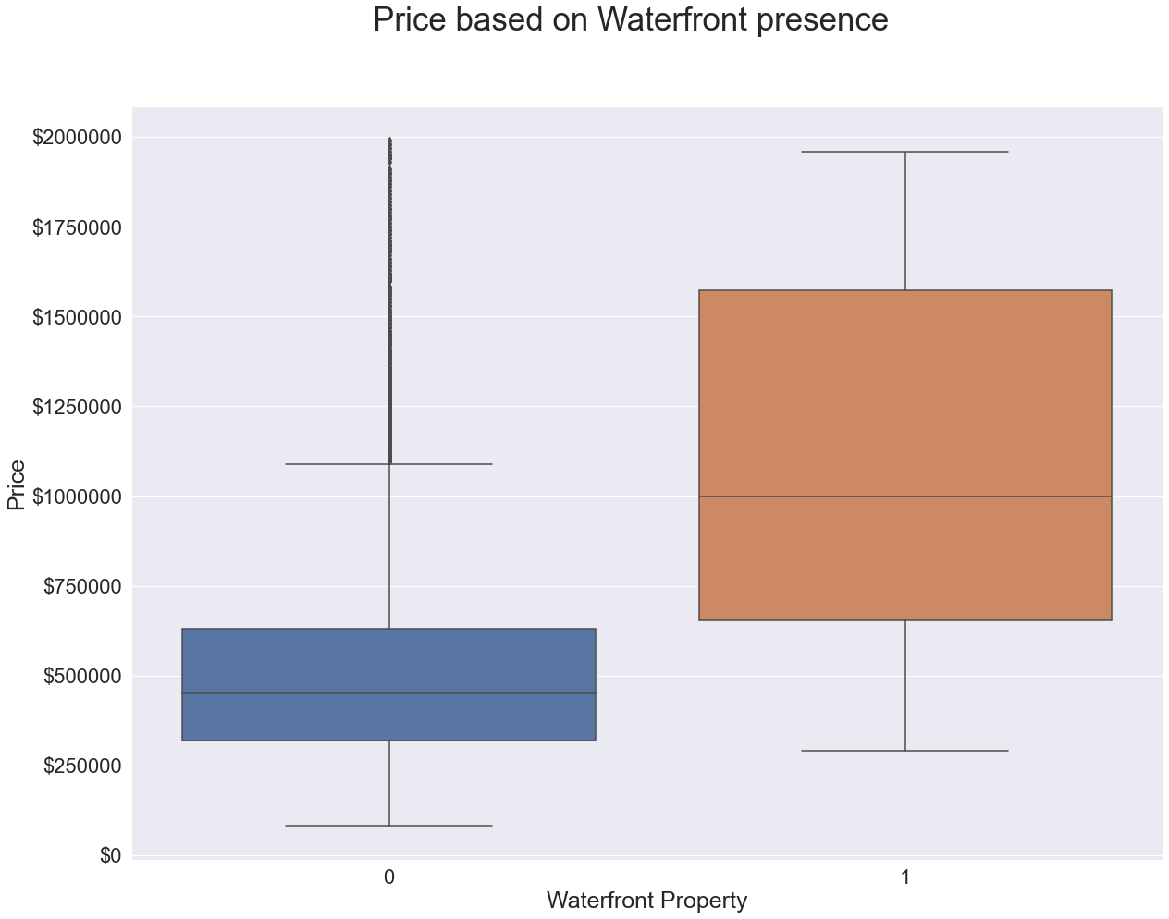
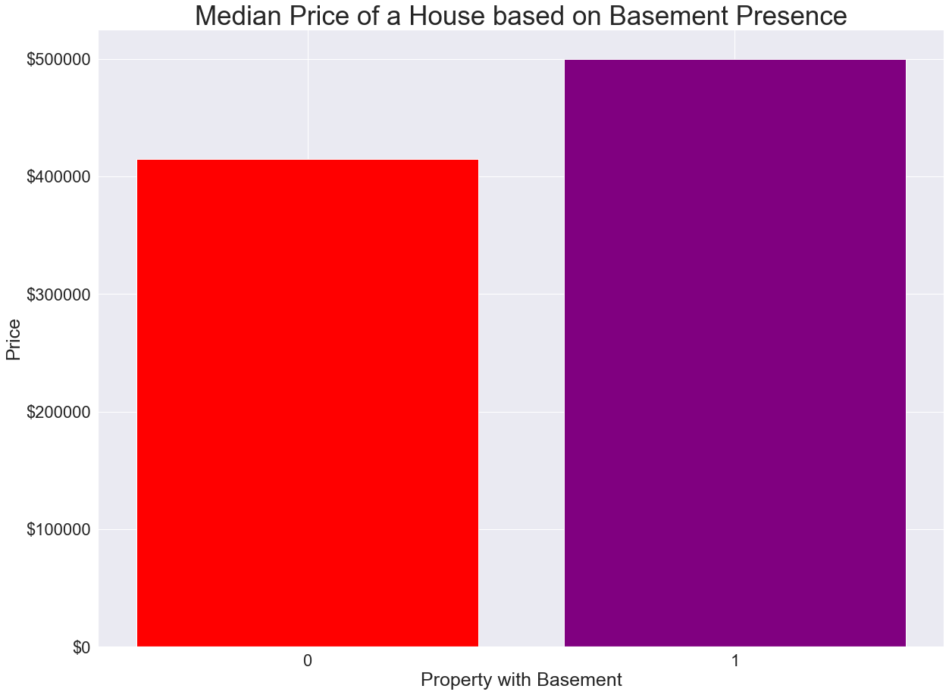
Variables important for modelling

Slide 8
Variables important for modelling

Slide 9
Improving the model
Initial model accuracy was 58%
Improved accuracy by adding zip codes
Removed variables that reduce accuracy
Accuracy in final model went up to 81%
Notes:
Used data from zipcode information in Kings County
Used as proxy for neighborhood
Vastly improved model performance
Removed some outliers
Removed variables that reduce accuracy
Similar to final model in accuracy, but not very tight
Removed houses over $2 million

Slide 10
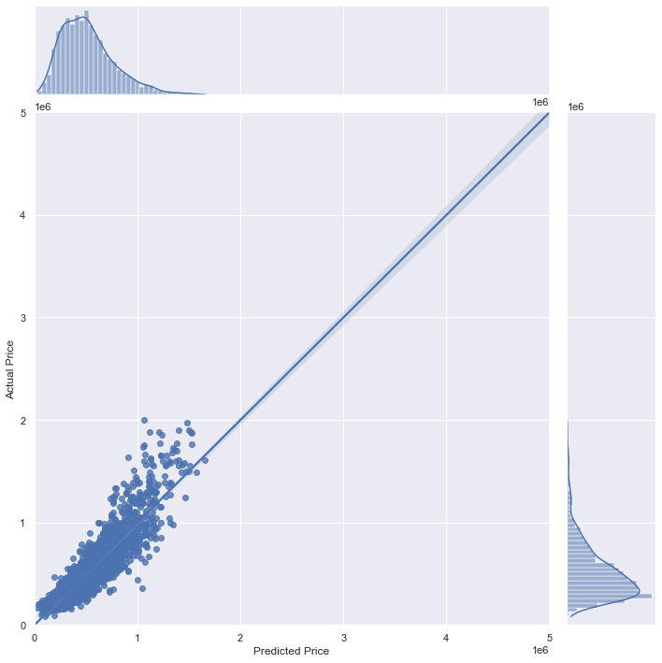
Final Model_2.0
R2 for test = 0.8179331164867534
MAE = 84158.5476377756
RMSE = 121944.63686923629

Slide 11
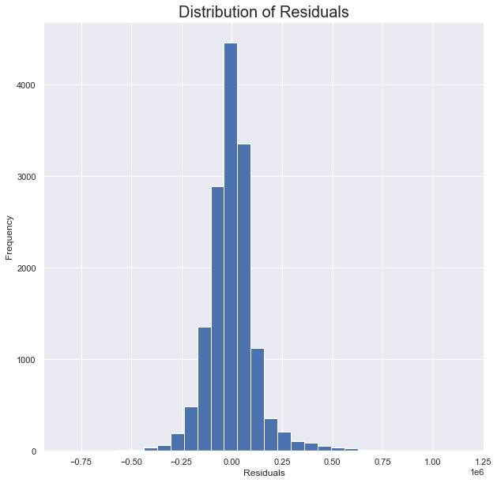

Slide 12
Recommendations
Important attributes in determining house prices in Kings County
Square footage of house (not size of property)
Waterfront Property
Presence of basement
A low bed to bath ratio
Zip code

